Slide 1

NBA ANALYSIS
An In-Depth Analysis and Prediction of NBA Games
A Capstone Project by:
Group-24
Vamshi Krishna Vallam
Kowshik Mannam
Pavankumar Jasti
Lawrence Abhinav Gunkonda
Under the guidance of:
Dr. Denise R. Philpot

Slide 2
Contents
Introduction
Business Understanding
Data Understanding
EDA / Data Analysis
Data Preparation
Model Building
Model Comparison and Predictions
Conclusion
References
Results

Slide 3

Introduction
Originated as the Basketball Association of America (BAA) in June 1946 in New York City.
Evolved into the National Basketball Association (NBA) comprising 30 teams, with 29 in North America and 1 in Canada.
Known for its thrilling games and the presence of top-tier players, the NBA has garnered a worldwide audience.
Emphasizes the athleticism of players, strategic gameplay, and diverse statistics.
Recent growth due to modern statistics, advanced technology, and detailed analysis by teams and fans.
NBA analytics aims to uncover patterns and provide insights for better decision-making and performance enhancement.

Slide 4
NBA Elo: A statistical system for measuring and forecasting team performance.
CARMELO Algorithm: Predicts future player performance using advanced metrics.
RAPTOR: A new statistic for assessing teams based on player tracking and on/off ratings.
Analytics have become crucial in various aspects such as player performance, team dynamics, salary management, and drafting.
This data-driven approach has changed how sports are understood and experienced, blending sports with technology and statistics.

Slide 5
Business Understanding and Research Questions
Rating Accuracy for Matches
Evaluate the accuracy of Elo ratings, CARMELO ratings, and RAPTOR ratings in predicting the outcomes of matches.
Match Quality's Impact on Importance and Total Rating
Analyze whether the quality of a match, as indicated by various factors, significantly influences its importance and the overall rating.
Influence of Match Quality on Match Outcomes
Investigate how the quality of a match, as determined by specific metrics, affects the final match outcome for the teams.

Slide 6
Business Understanding and Research Questions
Neutral Venue vs. Non-Neutral Venue Matches
Compare the differences in match outcomes (score 1 vs. score 2) between neutral venue and non-neutral venue matches for the Teams.
Team Performance Variations in Neutral Venues
Examine whether there are substantial variations in the performance of the teams in neutral venues compared to non-neutral venues.
Team Ratings During COVID-19
Explore the impact of the COVID-19 pandemic on the Elo, CARMELO, and RAPTOR ratings for the Teams, and understand how this period affected their performance.

Slide 7
Data Understanding
Data is gathered from the website ‘FiveThirtyEight.com’
Dataset includes information about the teams, season, ELO ratings, CARMELO Ratings, RAPTOR ratings, points scored, venue, etc.
This dataset contains 25 variables and 70688 rows.

Slide 8
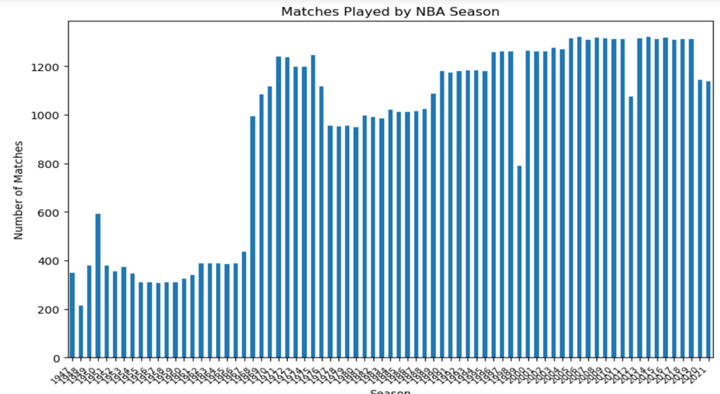
EXPLORATORY DATA ANALYSIS
Number of Matches Played Each Seasoneach season

Slide 9
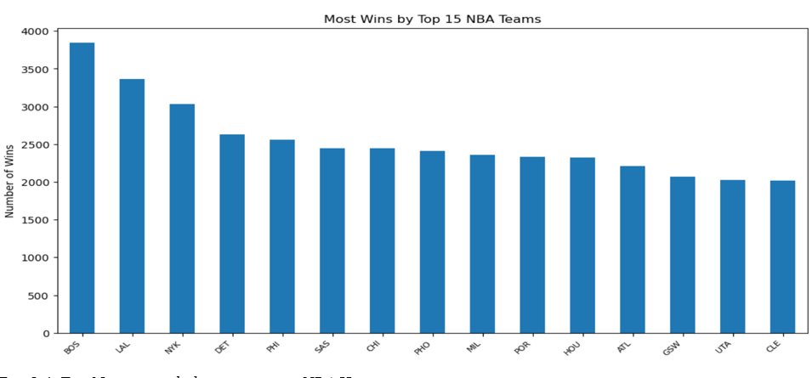
Total wins by the top 15 NBA teams.

Slide 10
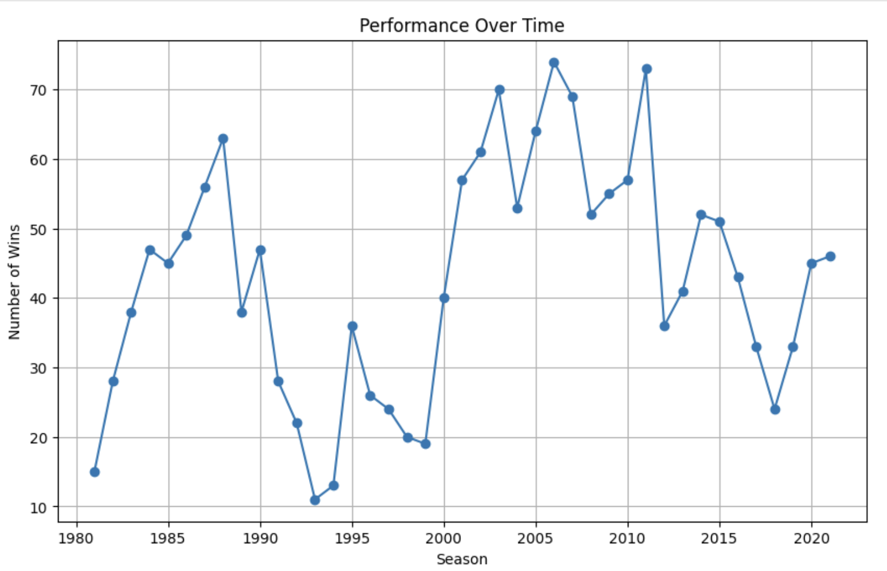
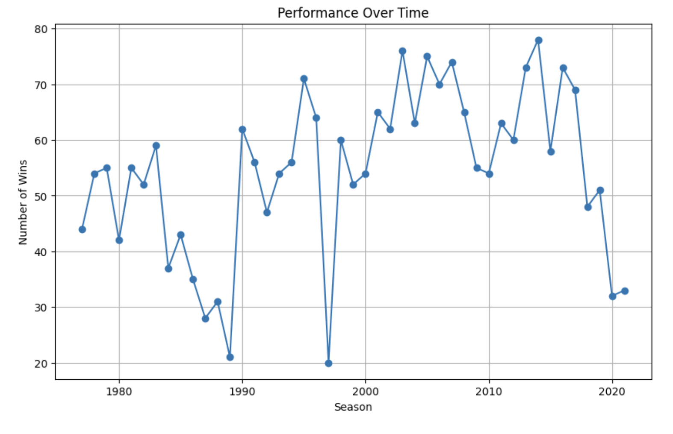
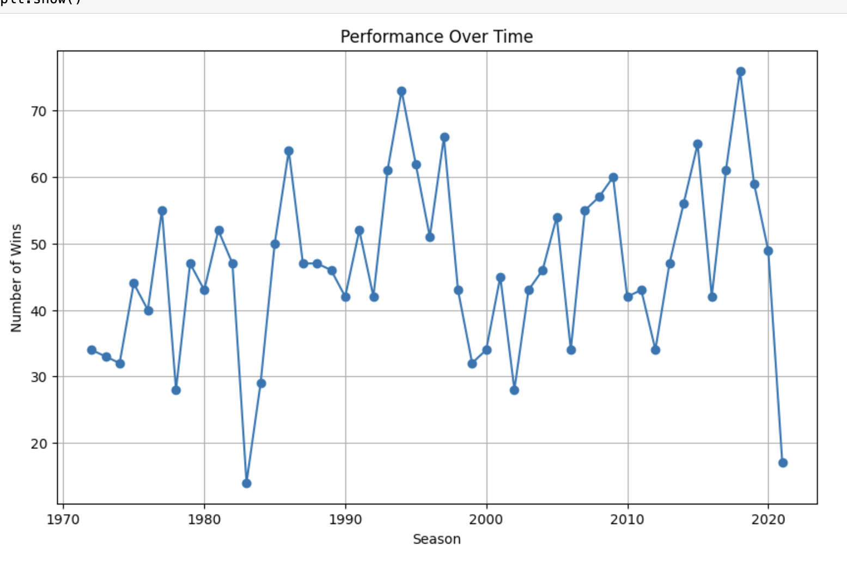
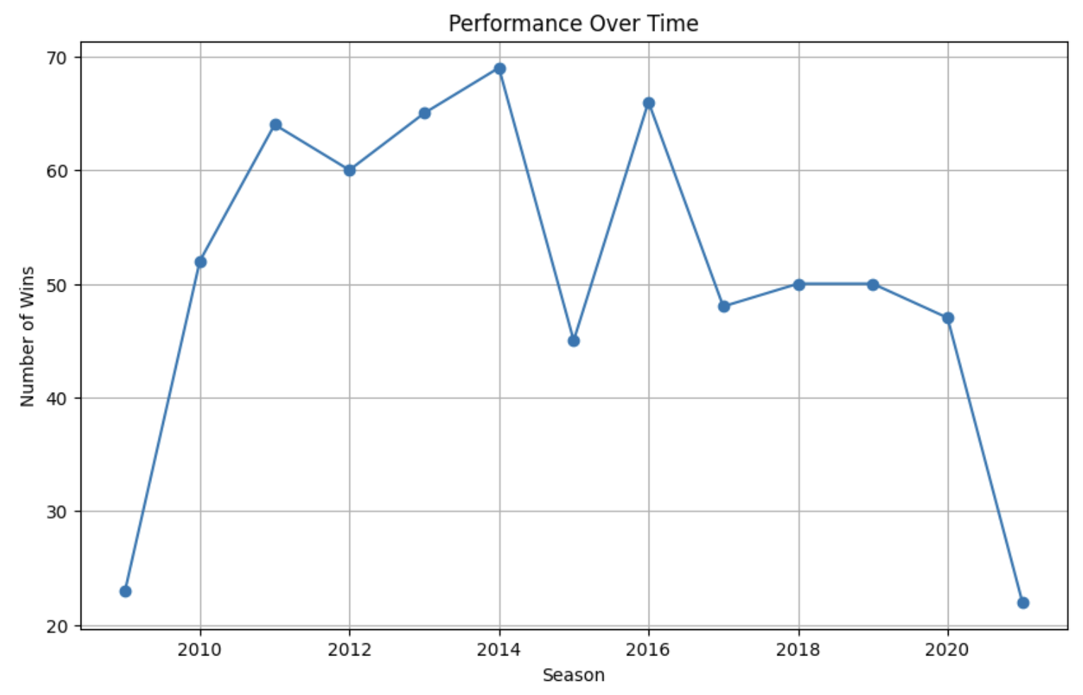
Visualizations of NBA teams in Texas.
Dallas Mavericks Team Performance
San Antonio Spurs Team Performance
Houston Rockets Team Performance
Oklahoma City Thunders Team Performance

Slide 11
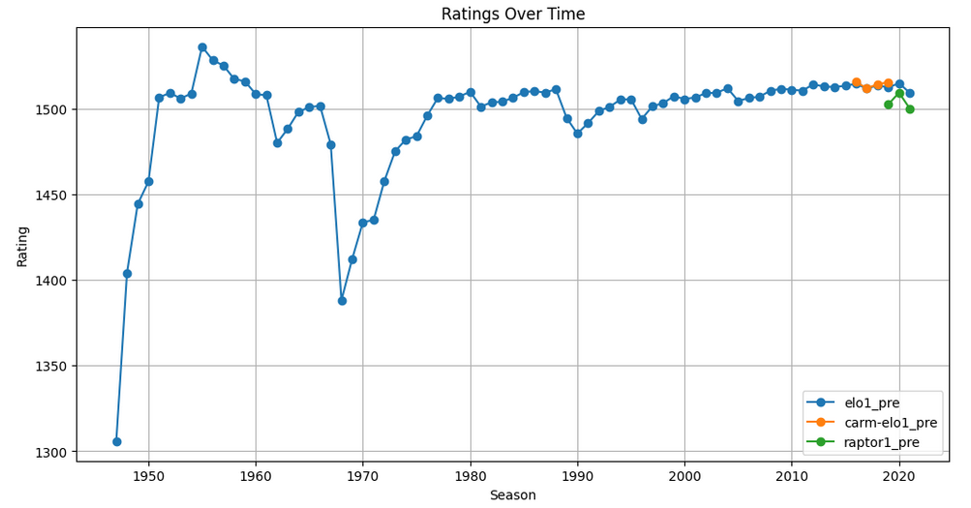
Ratings Over Time (Elo, CARMELO, RAPTOR)

Slide 12
Data Preparation
Null values removed.
Duplicates removed.
Scaled the data.

Slide 13
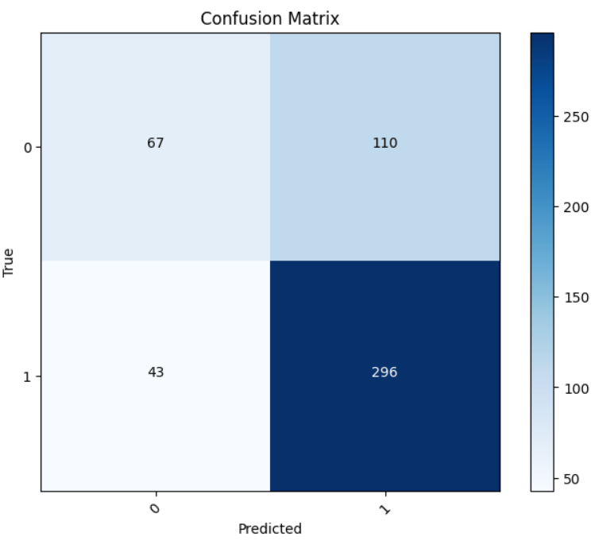
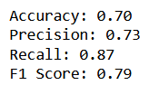
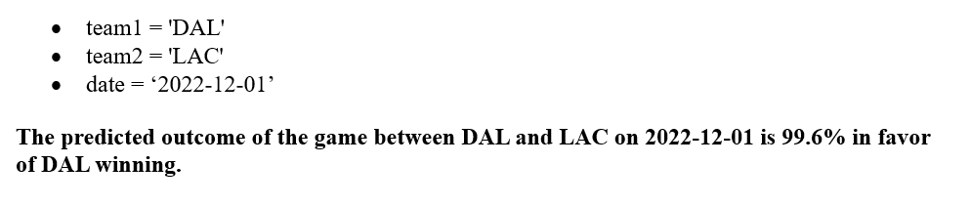
LOGISTIC REGRESSION
MODEL BUILDING AND PREDICTIONS

Slide 14
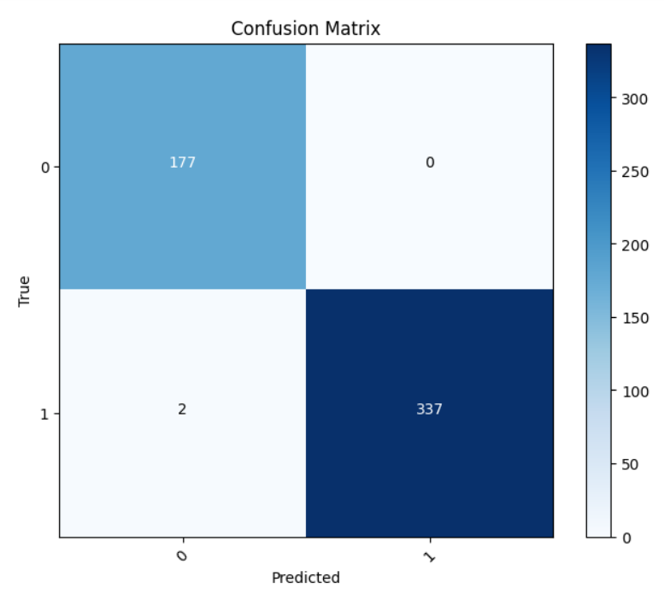
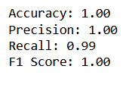
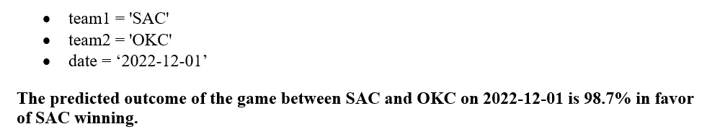
RANDOM FORESTS

Slide 15
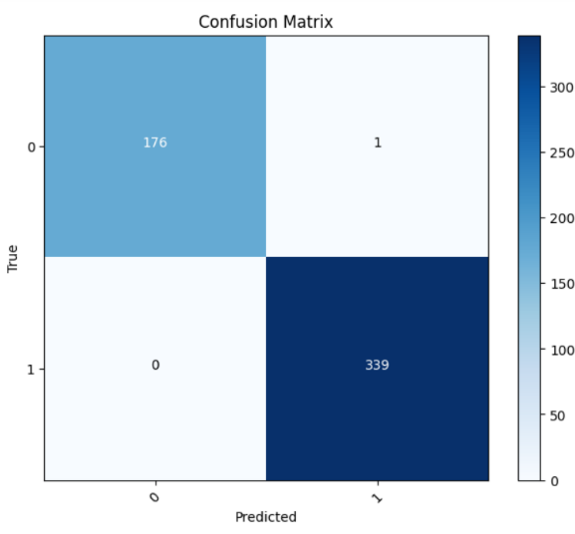
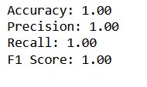
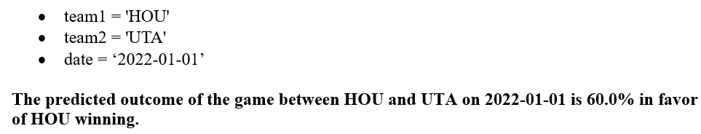
K-NEAREST NEIGHBOUR

Slide 16
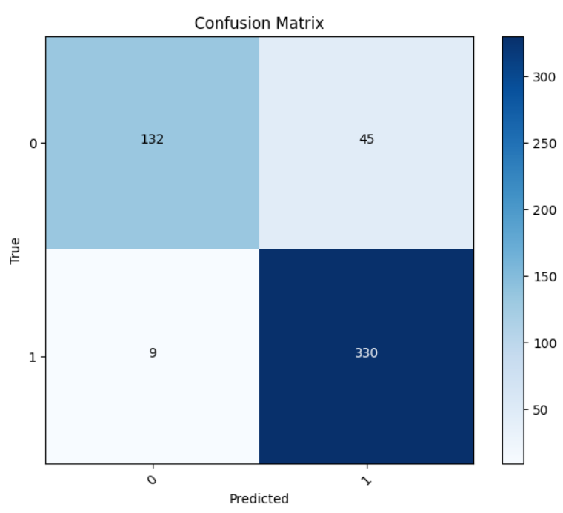
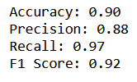
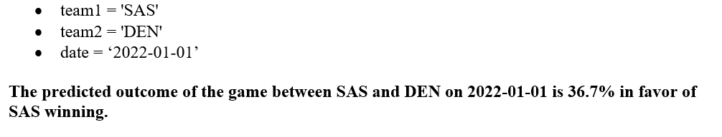
XGBOOST

Slide 17
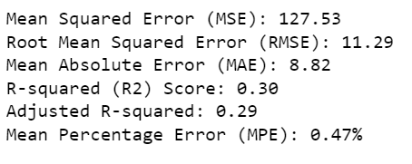
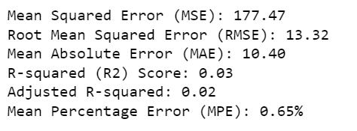
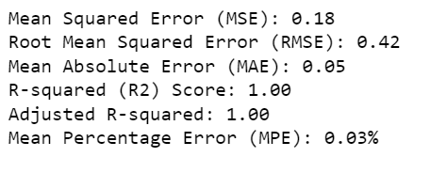
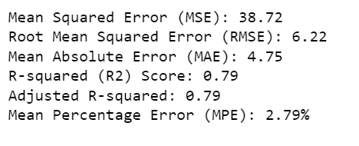
REGRESSION MODELS
Linear Regression
SVM
Random Forest
Gradient Boosting

Slide 18
RESULT
Accuracy of Ratings in Predicting Match Outcomes.
The Elo ratings, CARMELO ratings, and RAPTOR ratings are accurate predictors of match outcomes for all four teams. The models achieved high accuracy, precision, recall, and F1-score, indicating the reliability of these ratings in predicting match results.
Impact of Match Quality on Importance and Total Rating.
Analysis shows that higher match quality is positively correlated with match importance and total ratings. High-quality matches tend to have greater importance and receive higher total ratings. This suggests that match quality significantly influences these ratings.
Effect of Match Quality and Ratings on Match Outcome.
The models indicate that match quality, Elo ratings, CARMELO ratings, and RAPTOR ratings collectively influence match outcomes. Match quality has a substantial impact on match results. Higher-quality matches are more likely to lead to positive outcomes for the teams involved.

Slide 19
RESULT
4. Neutral vs. Non-Neutral Venue Matches.
Analysis reveals that neutral venue matches and non-neutral venue matches exhibit significant differences in match outcomes. Neutral venue matches tend to have closer scores and are more likely to result in ties or overtime. Non-neutral venue matches typically have more decisive outcomes with higher score differentials.
5. Variations in Team Performance in Neutral Venues.
Team performance in neutral venues varies significantly. Some teams excel in neutral venues, while others may struggle. These variations are evident in box plots that show differences in performance among different teams in neutral settings.
6. Ratings During COVID-19.
During the COVID-19 period, Elo, CARMELO, and RAPTOR ratings experienced fluctuations. Elo ratings remained relatively stable, while CARMELO and RAPTOR ratings exhibited some volatility. The models were able to capture these fluctuations, providing insights into how the pandemic affected team ratings.

Slide 20
CONCLUSION
Applied machine learning models to predict the match outcomes and match scores.
Different visualizations and analyses have been done to know the importance of match quality and, the effect of neutral and non-neutral venues on outcomes, and how the team ratings and performances were during COVID-19.

Slide 21
REFERENCES
Badenhausen, K. (2018, February 7). NBA Team Values 2018: Every Club Now Worth At Least
$1 Billion. Forbes.
https://www.forbes.com/sites/kurtbadenhausen/2018/02/07/nba-team-values-2018-every-ch_outcomes_using_machine_learning_techniques_some_results_and_lessons_learnedclub-now-worth-at-least-1-billion/?sh=623aac3a7155
Carmelo explained. NBAstuffer. (2023, July 13). https://www.nbastuffer.com/analytics101/carmelo/#:~:text=In%20a%20CARMELO%20calculation%2C%20a,to%20an%20average%20NBA%20player
Deb, S., Cacciola, S., & Stein, M. (2020, March 12). Sports leagues bar fans and cancel games amid coronavirus outbreaks. The New York Times. https://www.nytimes.com/2020/03/11/sports/basketball/warriors-coronavirus-fans.html
History. NBA Careers. (2019, February 20). https://careers.nba.com/history/#:~:text=The%20NBA%20is%20a%2070,used%20to%20host%20basketball%20games
Leung, C. K., & Joseph, K. W. (2014). Sports Data Mining: Predicting results for the College Football Games. Procedia Computer Science, 35, 710–719. https://doi.org/10.1016/j.procs.2014.08.153
Maher, M. J. (1982). Modeling association football scores. Statistica Neerlandica, 36(3), 109–118. https://doi.org/10.1111/j.1467-9574.1982.tb00782
McCabe, A., & Trevathan, J. (2008). Artificial Intelligence in Sports Prediction. Artificial Intelligence in Sports Prediction. https://doi.org/10.1109/itng.2008.203
natesilver538. (2019, October 10). Introducing raptor, our new metric for the modern NBA. FiveThirtyEight. https://fivethirtyeight.com/features/introducing-raptor-our-new-metric-for- the-modern-nba/
Reich, Y., Konda, S., Levy, S. N., Monarch, I., & Subrahmanian, E. (1993). New roles for machine learning in design. Artificial Intelligence in Engineering, 8(3), 165–181. https://doi.org/10.1016/0954-1810(93)90003-x
Witten, I. H., & Frank, E. (2002). Data mining. Sigmod Record, 31(1), 76–77. https://doi.org/10.1145/507338.507355
Zimmermann, A., Moorthy, S., & Shi, Z. (2013). Predicting college basketball match outcomes using machine learning techniques: some results and lessons. . . ResearchGate. https://www.researchgate.net/publication/257749099_Predicting_college_basketball_mat

Slide 22


Slide 23
PRESENTATION LINK
https://myunt.sharepoint.com/:v:/s/Capstone24/EWWjwcbOGihFijwadNM03w0BlLi3R_7qO2oLdY84yFydNA?e=PEL80V&nav=eyJyZWZlcnJhbEluZm8iOnsicmVmZXJyYWxBcHAiOiJTdHJlYW1XZWJBcHAiLCJyZWZlcnJhbFZpZXciOiJTaGFyZURpYWxvZy1MaW5rIiwicmVmZXJyYWxBcHBQbGF0Zm9ybSI6IldlYiIsInJlZmVycmFsTW9kZSI6InZpZXcifX0%3D

